Slide 1
Von Neuman
Hard Disk Drive

Slide 2
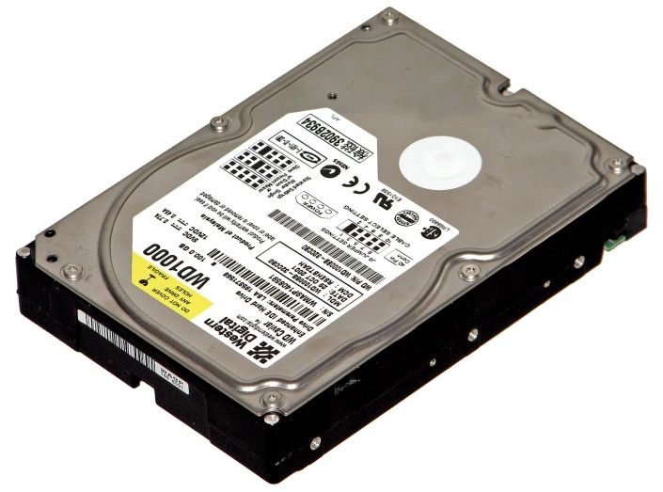
Introduction
A hard disk drive (HDD) is a data storage device used for storing and retrieving digital information using one or more rigid rapidly rotating disks (platters) coated with magnetic material.

Slide 3
HARD DISK DRIVE
It is a data storage device in a computer.
It is a secondary storage device.
Its stored in 0 (or) 1.
The operating system, software and most other files are stored in the HDD.
Its invented in 1954 by IBM.
Different capacities, such as 10GB, 20GB, 40GB, 80GB etc.

Slide 4
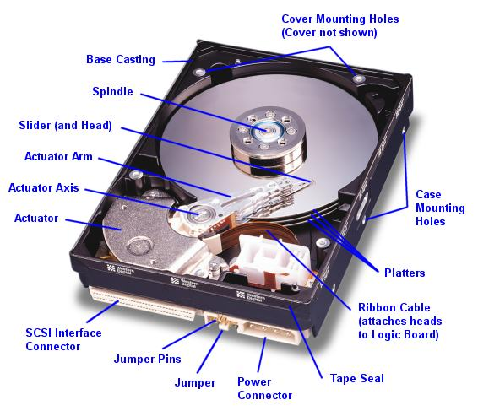
HARD DISK DRIVE COMPONENTS

Slide 5
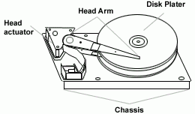
DISK PLATTER
The platter is made up of a magnetic material, in the flat disk part of the drive.
The data stored in the platter.
Each set of magnetic particles is collection a unit called a bit.
New hard-drive technology uses thin-film metals and glass platters to increase efficiency and drive storage capacity.

Slide 6
STEPPER MOTOR
The platter is made up of a magnetic material, in the flat disk part of the drive.
Use stepper motors for controlling read/write head position.
Stepper motors usually use +12V power, but some new low-power drives use +5V power source.

Slide 7
SPINDLE MOTOR
It control the platter.
This motor rotates at a speed of 3600 to 10,000 r.p.m
All the platter moves in the same direction.

